Slide 1
Business Intelligence
PROJECT REVIEW
Department of Artificial Intelligence and Data Science
Year : II Semester : IV
DHIVAKAR S - 927623BAD027

Slide 2

Wellness Metrics Unveiled

Slide 3
Introduction
Hospitals generate vast data daily, yet inefficiencies persist due to limited analytics. “Wellness Metrics Unveiled” leverages IBM Cognos Analytics to provide insights into hospital throughput, patient recovery, and critical care efficiency. By analyzing key metrics like bed occupancy and ER wait times, it enables data-driven decisions, optimizing resources and improving patient care.

Slide 4
Abstract
“Wellness Metrics Unveiled” is a dashboard that leverages IBM Cognos Analytics to visualize hospital throughput, patient recovery rates, and critical care efficiency. By analyzing key metrics like bed occupancy, ER wait times, and ICU utilization, it provides insights to optimize hospital operations. This project enables data-driven decision-making, improving resource allocation, patient care, and overall efficiency in healthcare.

Slide 5
🧩 Problem Statement
Design a dashboard to visualize hospital throughput, patient recovery rates, and critical care efficiency.

Slide 6
💡 Problem Solution
We developed an web-based dashboard using IBM Cognos Analytics that allows users to securely register, log in, and visualize key hospital performance and wellness metrics through dynamic charts and graphs. This empowers healthcare professionals to make informed, data-driven decisions for improving patient outcomes and operational efficiency.

Slide 7
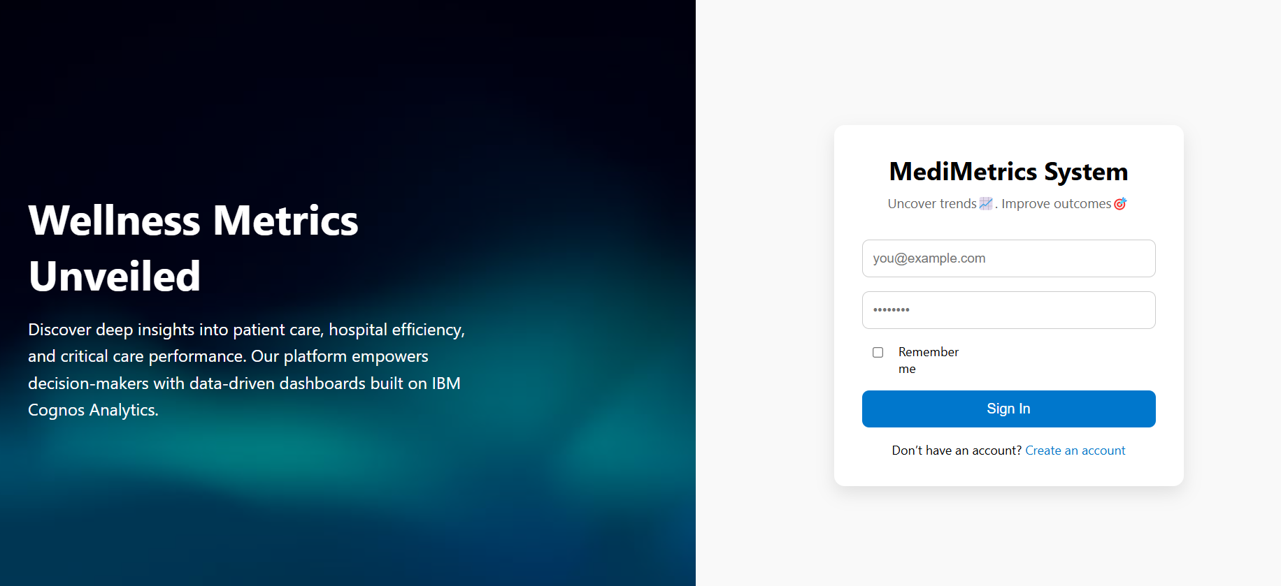
Login Page

Slide 8
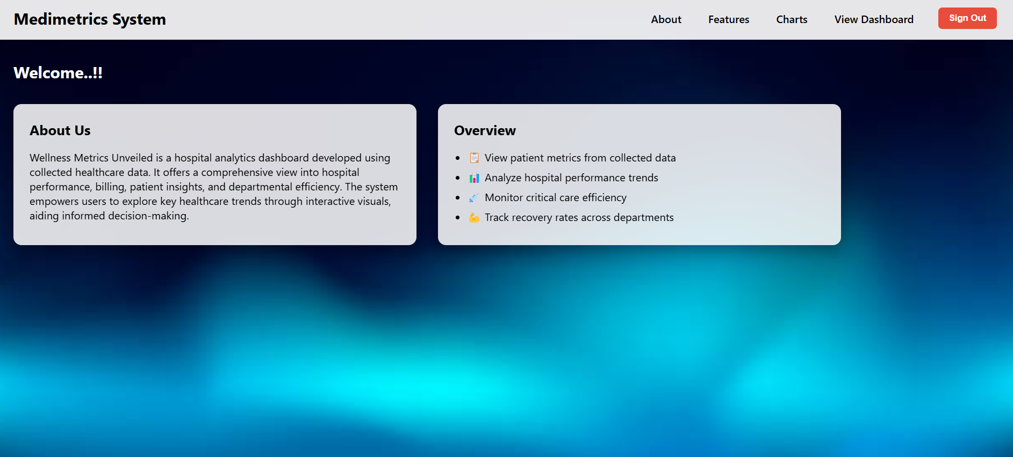
Summary Dashboard

Slide 9
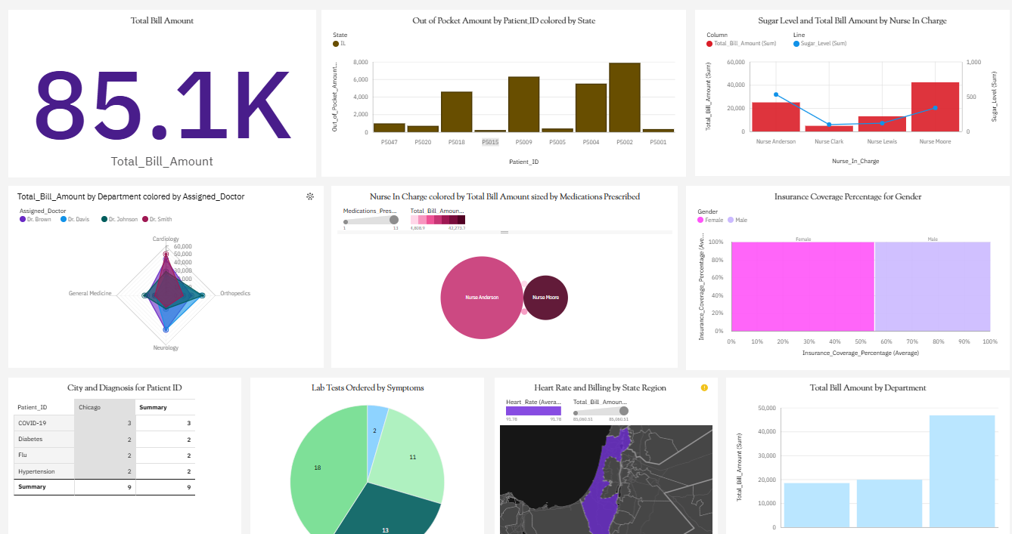
Dashboard

Slide 10
Existing Projects
Existing Projects Similar to This Several dashboards already monitor hospital performance, patient recovery rates, and critical care efficiency:
Bold BI – Tracks KPIs like readmission rates and wait times to improve patient and staff satisfaction. (BoldBI.com)
NetSuite – Provides financial insights and operational data for better decision-making. (NetSuite.com)
Tableau Healthcare – Uses data visualization to enhance medical data interpretation. (QuantizeAnalytics.co.uk)

Slide 11
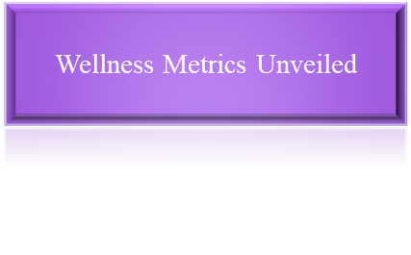
Project Workflow
Data Layer (Sources & Storage)
Data Processing Layer (ETL & Transformation Using IBM Cognos)
Analytics & Visualization Layer
UI & Decision-Making Layer

Slide 12
• Enables data-driven decision making for hospital management.
• Enhances patient care through better resource allocation.
• Utilizes IBM Cognos for integrated ETL, analysis, and visualization.
• Offers a secure, web-based dashboard for accessibility.
• Supports varied visualizations like bar charts, maps, pie charts, etc.
Advantages

Slide 13
This project uses IBM Cognos dashboards to visualize hospital performance, revealing key insights into patient recovery, billing trends, and care efficiency. It helps identify cost drivers, regional variations, and staff impact, supporting better decision-making and improved hospital management.
Conclusion

Slide 14
1.Dataset https://drive.google.com/file/d/1fsckknCYS-S9Qh-C6eAfJdHiPLjrpZ8q/view?usp=sharing
2.Github
Dharani R: https://github.com/Dharaniraju18/WellnessMetricsUnveiled
Dharsni S: https://github.com/Dharsni15/WELLNESSS-METRICS-UNVEILED
Dhivakar S: https://github.com/DHIVAKAR-AI/Wellness-Metrics-Unveiled
3.Report: https://drive.google.com/drive/folders/1eK0t9bO91b9qxTt_OfObkm0sGQEuwLV3
LINKS

Slide 15


